Slide 1
Mathematics takes a holiday
SWGDAM’s Y formula has no basis
Charles Brenner, Ph.D.
Purveyor of forensic mathematics,
DNA∙VIEW®,
UC Berkeley Visiting Scholar
charles@dna-view.com
http://dna-view.com
Notes:
Tuesday Feb 20 7pm
You may guess from my title slide that I will be criticizing some of the math – or lack thereof – in the SWGDAM, FBI-recommended Y haplotype guidelines. The recommended formula is born of confusion and therefore it causes confusion in court, which is a serious problem.

Slide 2
Outline
Stories
  Confused testimony assumes θ helps in a Native American context
The culprit: Pr(A│A) = θ + (1 – θ) p_{A}
  (SWGDAM YSTR guidelines Eq 3)
Analysis
  Impossible to have any “Eq3”-like formula given available data
Summary
Notes:
I’ll begin with a brief discussion of the “geography” problem, the problem which the formula looks like it’s supposed to solve but it does not.
Here’s the formula. It says that the matching probability – the probability that a wrongly accused suspect will have haplotype A given that haplotype A was observed at the crime scene – is a slightly complicated expression involving not only pA, the haplotype probability of occurrence, but also a mysterious number denoted as theta.
Two slides to introduce the formula I claim is a useless misleading imposter …
Analysis – “why it’s wrong”
I found a general yet very simple argument.
And wrap it up.

Slide 3
§1. Stories

Slide 4
Evolution of the Yfiler lineages
mutation
Y-chromosome Adam”
…
Convergent mutation (rare)
110,000 ybp
today
(Same color = same Y-haplotype)
Notes:
Begin by reviewing the story of Y evolution. It starts about 110K years ago with Adam, the most recent common patrilineal ancestor of all living men. He passed his Y on to at least 2 sons (CLICK - or he wouldn’t be most recent), and they had sons (CLICK) etc. An STR haplotype like Yfiler is usually transmitted unchanged, but about 5% of sons inherit a mutation – different color – and so Yfiler diversity evolves.
A large majority of mutations are to a brand new type. That is the opposite of what many people expect intuitively.

Slide 5
Basics of Y-haplotype diversity
Diversity of Y-haplotypes
  Metric: Average Pr(A|A)
Diversity increases over time
  Mutations
  Population size
Diversity limited/reduced by
  Small founding population
  Short history
  Population bottlenecks
population size
time
Notes:
So a population accumulates diversity – more haplotypes – through mutation.
Also if the population grows larger more of the mutations survive.
The flip side is that short history and small population size means less diversity

Slide 6
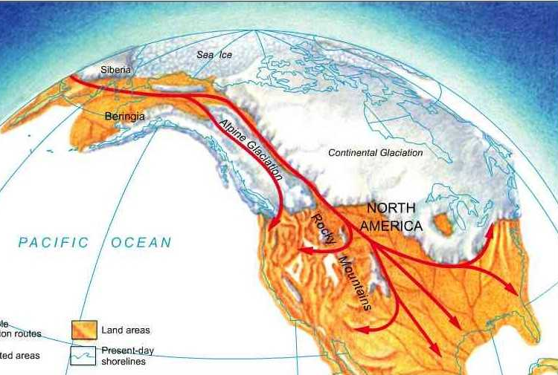
Manufacturing diversity
15000 years of diversity
Pr(A|A)≈ 1/3000
all Native Americans
Tribe: geographical subpopulation isolated from immigration
15,000 ybp
Y-
Hopi
600? years of diversity
1/10 < Pr(A|A) < ?
Notes:
Native Americans began to populate the Americas 15000 years ago. I assume that genetically and geographically separate subpopulations – tribes – formed from time to time.
Note – “population” here literally means Y-chromosomes, reasonably thought of like bacteria. Females participation is just incubation; they have no genetic or population-genetic role. There is no “HW equilibrium” concept. Even the males are essentially vessels.
The Y haplotypes of an insular community – Nat Am tribe for example – are not fairly represented by the pooled data from all the tribes. For the large population and 15K year age represented by pooled population data, the typical random match probability is 1/3000. For a much younger and smaller individual tribe it is much less; some data supports as little as 1/10.
The tribe will have much less diversity. Moreover its haplotypes may largely be tribe-specific types not existing elsewhere.

Slide 7
§1. Stories
Y haplotype evidence – the “geography” problem
  Tribe is less Y-diverse
  Tribe-specific Y haplotypes
  What if pooled Native American is only reference data?
Court testimony & confusion
  Lab analysts reasonably assume θ in SWGDAM formula must mean something, guess that it solves Native American tribe problem.
Notes:
The “geography problem” is: How then can we handle Y haplotype evidence within tribe? Can we manage when the only reference data is pooled?
One FBI expert witness testified
(Russell hearing transcript p147.2: )
"the scientists that looked at [the NatAm Y data] saw the clustering or the substructure that was present in that pooled database and they recognized that they could account for that substructure by doing the calculations that they performed.“
No, they neither saw nor recognized; the witness was guessing. But it’s understandable that she imagined the theta formula must mean *something*.

Slide 8
§2. The culprit
SWGDAM recommended formula to account for “population substructure”
  “It is recognized that population substructure exists for Y-STR haplotypes.”
Pr(A│A) = θ + (1 – θ) p_{A} (SWGDAM Eq 3)
  Derivation: guessed by analogy, invalid analogy.
    Analogy with autosomal formula based on autosomal definition: “population substructure” = result of preferential mating
  mathematics not invited
(SWGDAM: FBI’s
Scientific Working Group on DNA Analysis Methods)
Notes:
Recognized by whom? Anyone who knows – make that “doesn’t know” – what “population substructure” means here, raise your hand.

Slide 9
What does θ in this formula mean, and do, anyway?
Request SWGDAM for information by email Jan 8 to SWGDAM chairman
Information declined Jan 11 email from chairman Onorato
I'm … interested in the θ ideas in §10.3
I'm writing … to give the committee an opportunity to justify the published recommendations.
… what is the justification or provenance of Eq 3?
Who is responsible for the writing in the section?
How exactly is θ calculated?
… I have spoken several times with Bruce Weir on this subject.
… I have reviewed your inquiry with the leadership of SWGDAM and discussed the specifics with the current lineage marker committee. … I believe you have all information we can provide
Remarkable!
(SWGDAM: FBI’s
Scientific Working Group on DNA Analysis Methods)
Notes:
I don’t know exactly what I expected, but at least “how is theta calculated” is answerable – someone has a computer program that produced the tables of numbers in the SWGDAM paper.
The brazen stonewalling surprised me both in unapologetically being non-scientific behavior but also in being apparently suicidal. Am I supposed to NOT testify in court that the FBI advises prosecuting men by a method the logic for which, if any, is a secret?

Slide 10
§3. Analysis –
Eq3-like project impossible
Textbook meaning of θ:
  Theta: θ measures the allele frequency variation between subpopulations, where
  Subpopulation: Can be any, even arbitrary, subset of a population.
What is θ in Eq 3 supposed to do?
  Compensate for preferential mating (as autosomal)?
  Allow application to a subpopulation (magic!)?
What SWGDAM’s θ and Eq 3 really do:
  Not (a) nor (b) nor (c). Nothing sensible.
Notes:
Neither Eq 3 nor anything like it can possibly work.
Consider a picture and we’ll see why

Slide 11
Native AmericanYfiler lineage tree
Tribe#1
Nat Am founders
Tribe#2
Substructure?
…
15,000 years ago
today
Notes:
Picture, if you will, the lineage tree of all Native American Yfiler haplotypes.
Let’s think what “substructure” means.
If groups of people sometimes wander away and start separate tribes, would that create “Y-STR substructure”?

Slide 12
Why Eq3-like project impossible
Thought experiment:
  Suppose Native Americans never split into tribes.
  How would today’s Y-haplotype population be different?
  Y-haplotype reproduction: clonal (not sexual)
  Therefore females are genetically irrelevant.
  Therefore no difference: Every Y-population is equally probable either way, tribes or no tribes.
Conclusion: No way to infer “substructure” from Y-haplotype population.
Yet SWGDAM’s θ is calculated from Y-haplotype population. Hence whatever it is, it’s irrelevant to “substructure.”
Notes:
Every population )of Y haplotypes( is equally probable …
…irrelevant to “substructure” )whatever that is(, so irrelevant.

Slide 13
§4. Summary
How to compute Y-haplotype matching probability given population reference data
  from the appropriate population?
  From the wrong population?
SWGDAM’s Y calculation formula
  Random guesswork but influential in court
  Confusion and error in court in tribal context (b).
What to do?
  Dis-recommend the formula and anything like it.
  Survey tribes individually.

Slide 14
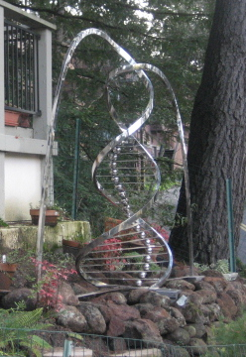
The rules of genetics are simple.
Their consequences are not always obvious.
The end
charles@dna-view.com
http://dna-view.com
☎510 798 7139

